Slide 1
Hacking Identity
A Pen Tester’s Guide to IAM

Slide 2

Who Am I?
Music teacher turned hacker
Security Solutions Architect, One Identity
Certs
ACE
CISSP
GWAPT
GWEB
Groups
ISSA
OWASP

Slide 3
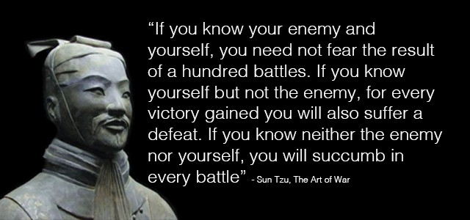
Still Relevant

Slide 4
The Challenge

Slide 5

F5: Lessons Learned from a Decade of Data Breaches

Slide 6
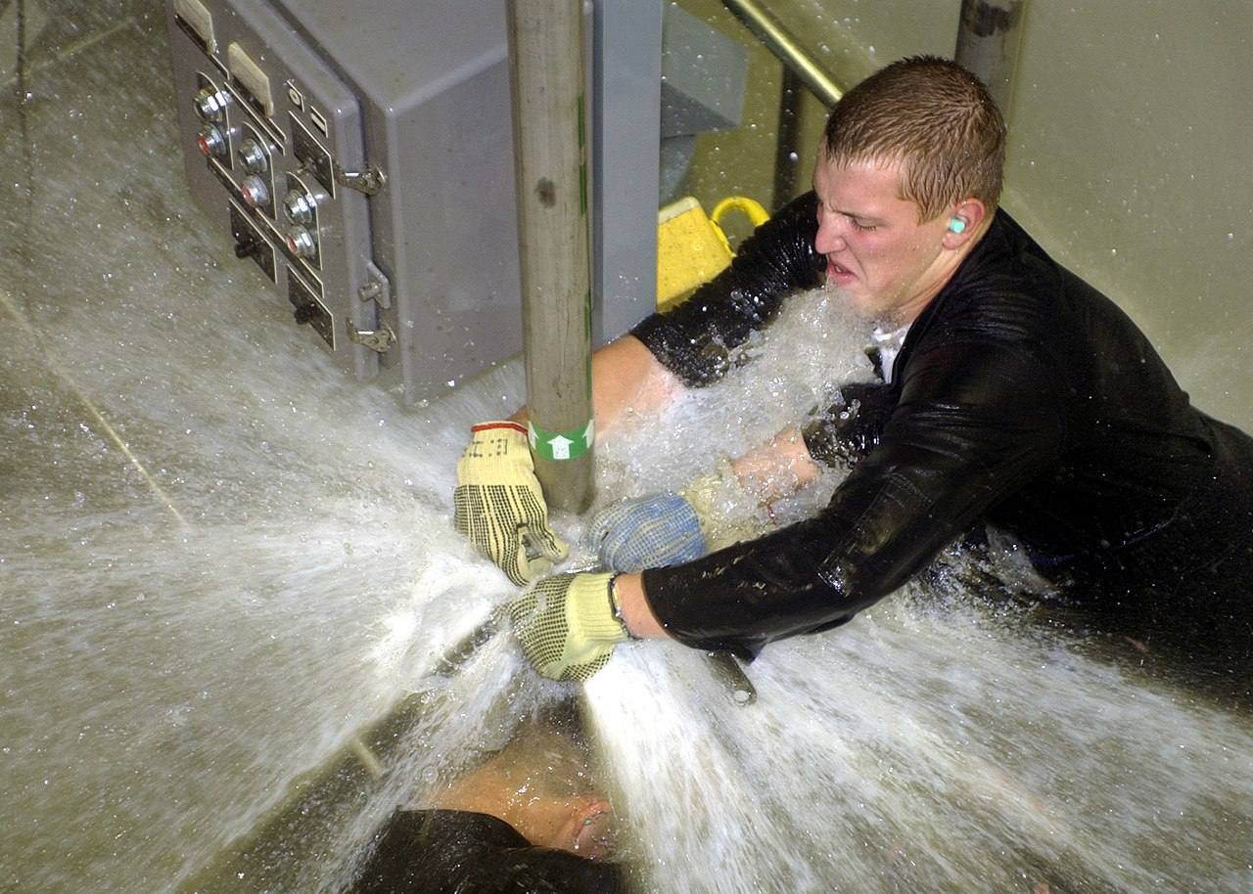
Let’s Talk Attack Surface
Publicly available user information
Open Source Intelligence (OSINT) gathering
Social media, corporate email used on personal sites
Publicly available system information
Hostnames, IP addresses, DNS servers, mail servers
It’s how the Internet works, folks
Increasing reliance on software-as-a-service (SaaS)
Corresponding increase in password reuse and unmanaged user accounts
Notes:
Necessary risks
Information leakage
Ashley Madison breach (users registered with corporate email addresses)
Twitter story (passwords in plaintext; password reuse)

Slide 7

Day 19: They Still Suspect Nothing
Notes:
Attackers are frequently going after valid user credentials so they can impersonate an existing user, abuse that user’s privileges, and (hopefully) maintain a persistent presence on your internal network without being detected.

Slide 8

Pen Testing: Ten Eight Step Process
Step 1: Gather OSINT
Step 2: Score Some Creds
Step 3: Logon to an Internal System
Step 4: Dump SAM/System/Security Hives
Step 5: Extract Hashes and Get Cracking
Step 6: Identify Admin Accounts
Step 7: Find Active DA Logins
Step 8: Pass the Hash
Notes:
Pen test process is refined
Unauthorized outsider to domain admin before lunch
If they can’t score creds, the entire attack falls apart
By the same token, if you’re able to detect when a user has lost control of his/her creds, you can shut the attack down before too much damage is done

Slide 9

Nothing New Under the Sun
Dumping Windows Credentials (December 20, 2013)
https://www.securusglobal.com/community/2013/12/20/dumping-windows-credentials/
I Hunt Sys Admins (January 19, 2015)
http://www.harmj0y.net/blog/penetesting/i-hunt-sysadmins/
Password Spraying Outlook Web Access (February 17, 2016)
http://www.blackhillsinfosec.com/?p=4694
Notes:
Tools and techniques are coming out at a rapid rate
Bug bounty programs
GitHub tools

Slide 10

What If I Told You…
Notes:
Know your enemy, know yourself
By taking a few minutes to get a better understanding of IAM, you can identify and address weaknesses in that process

Slide 11
IAM Primer

Slide 12
TLA’s and FLA’s
IdM = Identity Management
Manage the accounts
IAM = Identity & Access Management
Manage what the accounts can access
FIdM = Federated Identity Management
Manage identity across autonomous domains
LDAP = Lightweight Directory Access Protocol
RBAC = Role Based Access Control
SSO = Single Sign-On
Federation = SSO across multiple enterprises
ADFS, SAML, OAuth, OpenID, WS-Federation, etc.

Slide 13

It Giveth and IT Taketh Away
Entitlements – The things tied to a user (hardware, licenses, access, etc.)
Attributes – Flags that indicate which things a user should have
Provisioning – Granting entitlements to a user account
Deprovisioning – Removing entitlements from a user account
Notes:
Provisioned (automated vs. manual)
Transfers
Terminations (user no longer employed; account still active)
Understand the flow (lifecycle)

Slide 14
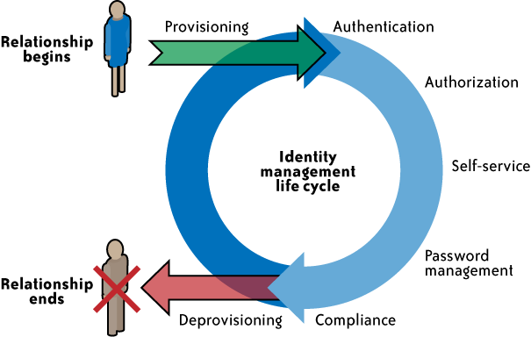
User Lifecycle
Image via KuppingerCole
Notes:
KuppingerCole describes consumer-centric IAM as employee IAM with different privileges
Many of the principles overlap
Integration points = weakest links
All employees are users, but all users are not employees.

Slide 15

Who (Traditionally) Does What?
Help Desk
Fields access issues, including password resets
Security Operations Center
Monitors log data
Security Team (Analysts, Architects, Engineers)
Sets policy
May manage the IAM toolset
Notes:
Why is this important?
Help Desk wants to help people. They tend to be new to IT/Security, and they often follow and established process (pattern of behavior).
Security Team tends to have more experience. Less likely to fall for SE.
SOC is trained on detection and response, and they spend their time reviewing logs and alerts. Your level of stealth will vary based on whether or not the target has a SOC (in house vs. outsourced)
In smaller orgs, teams who have to do ALL of this are spread way too thin.

Slide 16
Identity-Based Attacks
Notes:
5 techniques you should integrate into your pen testing process to vet the strength of an organization’s IAM controls

Slide 17
OSINT Gathering
Systems
People
Shodan - https://www.shodan.io/
Censys - https://censys.io/
Find Subdomains - https://findsubdomains.com/
HE BGP Toolkit - https://bgp.he.net/
SPF Records - https://mxtoolbox.com/spf.aspx
LinkedIn - https://www.linkedin.com/
Hunter - https://hunter.io/
Pastebin - https://pastebin.com/
IntelTechniques - https://inteltechniques.com/menu.html
Recon-ng - https://bitbucket.org/LaNMaSteR53/recon-ng
Discover - https://github.com/leebaird/discover
Notes:
More recon than attack, but crucial
OSINT gathering, Pastebin (creds)
Especially on personal sites
Shodan = all systems
Censys = web servers (login pages, SSL VPN)
Find Subdomains = web apps (login pages)
BGP Toolkit = IP/DNS neighbors
SPF Records = trusted SaaS

Slide 18

Document Metadata
Metagoofil
https://github.com/laramies/metagoofil
https://tools.kali.org/information-gathering/metagoofil
Sample Command
metagoofil -d target.org -t docx,xlsx,pdf -l 100 -n 25 -o out_directory -f out_file.html
FOCA (ElevenPaths)
https://www.elevenpaths.com/labstools/foca/index.html
https://github.com/ElevenPaths/FOCA
Process
Download files
Extract the metadata
Analyze the metadata
Notes:
OSINT gathering = grab everything
Analysis = context

Slide 19

What Are We Looking For Again?
Technology stack
Admin guides
New User / New Hire how-to guides
How to login to the VPN
Default passwords for new hires
User naming convention
Login portals
Webmail
SSL VPN
Password Self-Service
Notes:
Admin accounts are still identities that must be managed

Slide 20
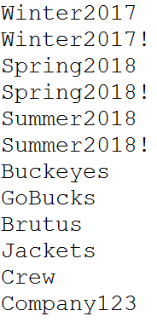
Password Spraying
Brute Force Attack
Lots of usernames, lots of passwords
Password Spray Attack
Lots of usernames, VERY few passwords
./ntlm-botherer.py –U ./users.txt –p Summer2018! –d target_domain.com https://webdir2a.online.lync.com/Autodiscover/AutodiscoverService.svc/root/oauth/user?originalDomain=target_domain.com/WebTicket/WebTicketService.svc
Burp Suite Intruder / Cluster Bomb
https://portswigger.net/burp/help/intruder_using.html
https://portswigger.net/burp/help/intruder_positions.html
MailSniper
https://github.com/dafthack/MailSniper
Notes:
Snag creds with spray attack
Search inboxes with MailSniper
Comb LinkedIn for new users, then SE the Help Desk for default password scheme

Slide 21

Once You’re In…
Steal creds or forge tickets
Mimikatz -> https://github.com/gentilkiwi/mimikatz
Kereberoast -> https://github.com/nidem/kerberoast
Power Shell Empire -> http://www.powershellempire.com/
Escalate privileges with PowerUp
Part of PowerSploit (PowerShell Post-Exploitation Framework)
https://github.com/PowerShellMafia/PowerSploit/tree/master/Privesc
Notes:
If you don’t know PowerShell yet, it’s time to learn.
Golden/Silver Ticket attacks – “Free, long duration tickets for any user”
Kerberoasting
Extract all accounts in use as SPN using built in MS tools
Request tickets
Extract the acquired tickets from RAM with Mimikatz
Crack with rgsrepcrack
Rewrite (make user appear to be different user / add to DA)
Inject back into RAM with Mimikatz
PowerUp looks for a process running with higher privs, attempts to exploit that process to run commands using that level of privilege

Slide 22
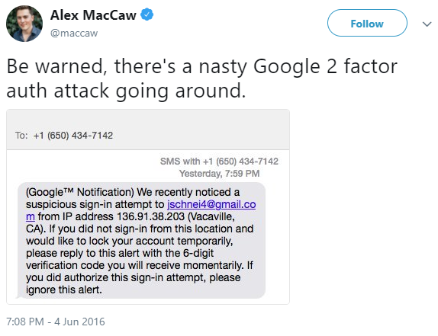
Social Engineering (SE)
Notes:
Two factor helps, but it isn’t the end-all/be-all of defense
Two factor can shut down brute force and password spray attacks
If your SE program stops with the Amazon gift card phishing email, you’re doing your users a disservice

Slide 23
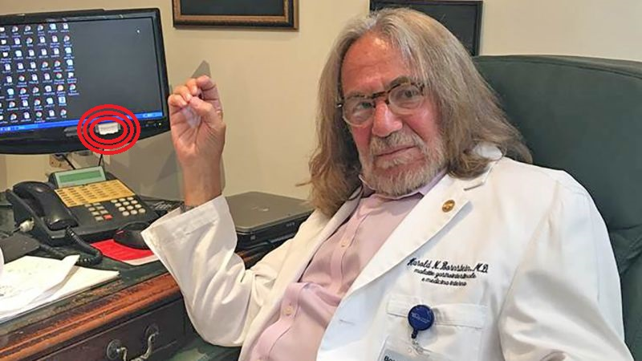
SE Attack Scenarios
Physical
“Site inspection“
Look for sticky notes & whiteboards
Phone calls
Help desk (tried and true)
Third party technology integrators (exploit complexity)
Password reset notification for SaaS apps
Social Engineer Toolkit (SET)
https://github.com/trustedsec/social-engineer-toolkit
Notes:
Dr. Harold Bornstein (Harold.Bornstein.98 on Facebook; posted 12/15/2016)

Slide 24
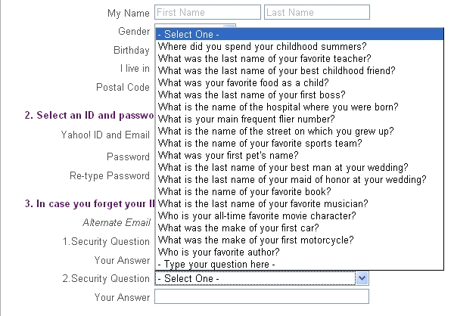
Password Self-Service
How easily can we find these answers?
MyLife - https://www.mylife.com/
FamilyTreeNow - https://www.familytreenow.com/
Combine with social engineering attacks
“Fun” quizzes on social media
Notes:
What’s your porn star name?

Slide 25

Self-Registration
Notes:
The killer is inside the house!
If you can self-register for any apps/services, you can impersonate a valid user
Discuss the value of this attack to a web application penetration tester (explore user account functions + modify other user accounts)
Drupal example

Slide 26
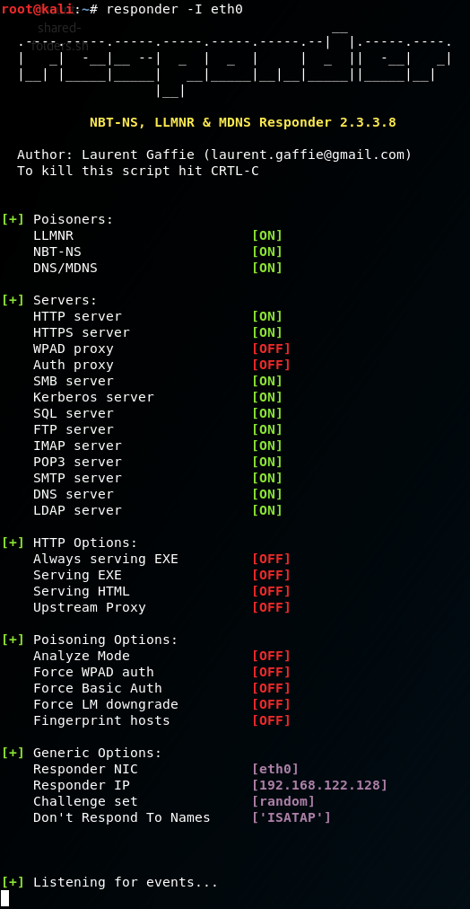
Responder
Why does Responder work?
Can’t resolve hostname via DNS? Try Link-Local Multicast Name Resolution (LLMNR).
No luck with LLMNR? Try NetBIOS Name Service (NBT-NS).
If any system replies, you can trust it. No need for validation.
Web browsers automatically detect proxy settings via Web Proxy Auto-Discovery (WPAD) protocol.
Fire up Responder
# responder –I eth0
WPAD, force client to authenticate
# responder -I eth0 –wF
Notes:
Again, goal is to score valid creds

Slide 27

It Only Takes One Set of Creds

Slide 28
Defense

Slide 29
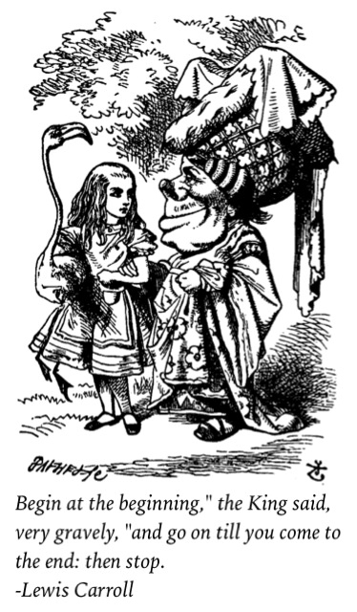

Where to Begin?

Slide 30
Analyze Your External Attack Surface
OSINT gathering
Port scans
Nmap - https://nmap.org/
Vulnerability scans
Nexpose (Rapid7) - https://www.rapid7.com/products/nexpose/
Nessus (Tenable) - https://www.tenable.com/products/nessus/nessus-professional
OpenVAS (open source) - http://www.openvas.org/
QualysGuard (Qualys) - https://www.qualys.com/qualysguard/

Slide 31
Reduce SAID Attack Surface
Consolidate (or eliminate) Internet-facing systems and applications
Close network ports that don’t need to be open
Remove unnecessary files & replace existing files (sanitize metadata)
Disable inactive accounts
Remove unnecessary privileges
User access attestation process
Implement multifactor authentication
VPN + On-Prem Apps + SaaS Apps
Security awareness training
Don’t use corporate email for personal sites
Don’t overshare on social media
How to detect AND respond to social engineering attacks

Slide 32
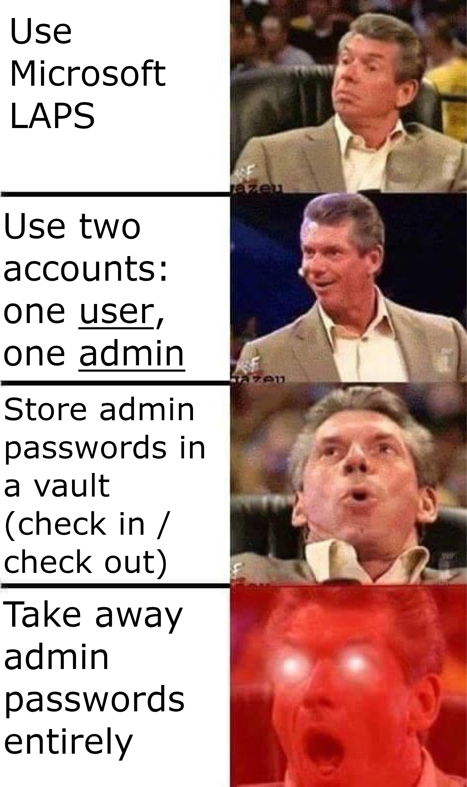
Tighten Up Admin Privileges
Stronger passwords
Users = 8 characters, alphanumeric, upper + lower + special
Admins = same complexity, but 20 characters
Limit local admin rights
Local Administrator Password Solution
https://technet.microsoft.com/en-us/mt227395.aspx
Privileged Account Management
Privileged Session Management

Slide 33

Detection is King
Technology
Log Management = long term
Security Information Event Management = short term
Define normal
Who has access to what?
What does normal access look like (times, traffic volume, etc.)?
Baseline privileged account activity
Monitor for changes to privileged accounts and groups
Passwords, domain group memberships, local group memberships

Slide 34
Logging and Monitoring – Web Servers
Excessive access attempts to non-existent files
Code (SQL, HTML) seen as part of the URL
Access to extensions you have not implemented
Web service stopped/started/failed messages
Access to “risky” pages that accept user input
Look at logs on all servers in the load balancer pool
Error code 200 on files that are not yours
Failed user authentication | Error code 401, 403
Invalid request | Error code 400
Internal server error | Error code 500
From https://zeltser.com/security-incident-log-review-checklist/

Slide 35
Logging and Monitoring – Network Devices
Look at both inbound and outbound activities.
Examples below show log excerpts from Cisco ASA logs; other devices have similar functionality.
Traffic allowed on firewall | “Built … connection”,“access-list … permitted”
Traffic blocked on firewall | “access-list … denied”,“deny inbound”, “Deny … by”
Bytes transferred (large files?) | “Teardown TCP connection … duration … bytes …”
Bandwidth and protocol usage | “limit … exceeded”,“CPU utilization”
Detected attack activity | “attack from”
User account changes | “user added”,“user deleted”, “User priv level changed”
Administrator access | “AAA user …”,“User … locked out”, “login failed”
From https://zeltser.com/security-incident-log-review-checklist/

Slide 36
Logging and Monitoring – Linux
From https://zeltser.com/security-incident-log-review-checklist/
Successful user login | “Accepted password”,“Accepted publickey”, “session opened”
Failed user login | “authentication failure”,“failed password”
User log-off | “session closed”
User account change or deletion | “password changed”,“new user”, “delete user”
Sudo actions | “sudo: … COMMAND=…”“FAILED su”
Service failure | “failed” or “failure”

Slide 37
Logging and Monitoring – Windows
From https://zeltser.com/security-incident-log-review-checklist/
Event IDs are listed below for Windows 2000/XP. For Vista/7 security event ID, add 4096 to the event ID.
Most of the events below are in the Security log; many are only logged on the domain controller.
User logon/logoff events | Successful logon 528, 540; failed logon 529-537, 539; logoff 538, 551, etc
User account changes | Created 624; enabled 626; changed 642; disabled 629; deleted 630
Password changes | To self: 628; to others: 627
Service started or stopped | 7035, 7036, etc.
Object access denied (if auditing enabled) | 560, 567, etc

Slide 38
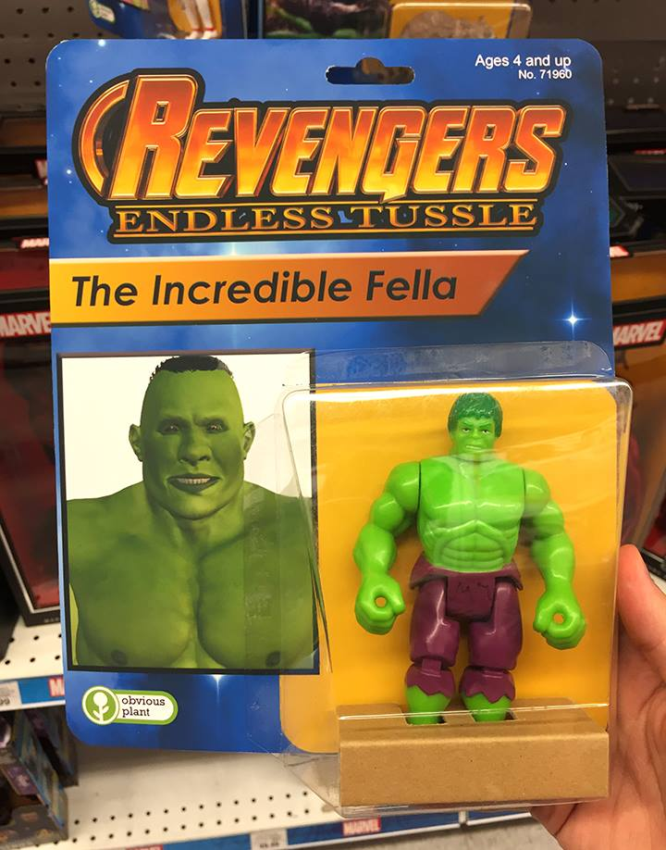
Misdirection
Fake admin account(s)
Systems and apps
Obvious names (admin, administrator, root) / limited access
In AD, attackers will be looking for SID 500
DISABLE THE ACCOUNTS (so they can’t actually login anywhere)
Honeycreds / Honeytokens
https://github.com/Ben0xA/PowerShellDefense/blob/master/Invoke-HoneyCreds.ps1
https://canarytokens.org/generate

Slide 39
A Few Final Comments

Slide 40
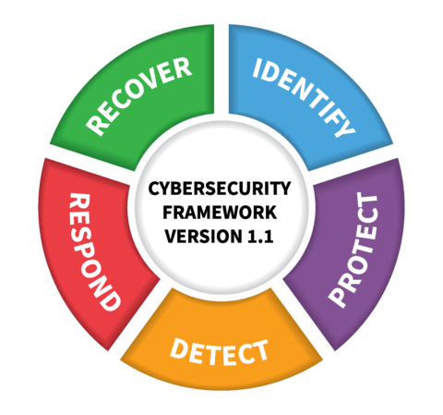
Fundamentals FTW
Prevention
System, network, & application hardening
Detection
Logging and monitoring
Response
End user security awareness training
IT/Security employee training
Image via NIST

Slide 41
Resources
Identity and Access Management 101
https://www.slideshare.net/JerodBrennenCISSP/identity-and-access-management-101
What You Need to Know About OSINT
https://www.slideshare.net/JerodBrennenCISSP/what-you-need-to-know-about-osint
https://www.youtube.com/watch?v=aaN6OCpBBaQ
Performing OSINT Gathering on Corporate Targets
https://www.pluralsight.com/courses/osint-gathering-corporate-targets
Buscador OSINT VM
https://inteltechniques.com/buscador/

Slide 42
More resources
IT and Information Security Cheat Sheets
https://zeltser.com/cheat-sheets/
Detecting Offensive PowerShell Attack Tools
https://adsecurity.org/?p=2604
LLMNR and NBT-NS Poisoning Using Responder
https://www.4armed.com/blog/llmnr-nbtns-poisoning-using-responder/
Common Sense Security Framework
https://commonsenseframework.org/

Slide 43
Even More Resources
F5 – Lessons Learned from a Decade of Data Breaches
https://f5.com/labs/articles/threat-intelligence/cyber-security/lessons-learned-from-a-decade-of-data-breaches
Consumer-Centric Identity Management (KuppingerCole)
https://www.slideshare.net/shivan82/2016-0426-webinar-consumerfocused-identity-management
How IAM can help move the finish line for hackers
https://www.csoonline.com/article/3276446/identity-management/how-iam-can-help-move-the-finish-line-for-hackers.html

Slide 44
Questions / Comments / Discussion

Slide 45

Contact Info
Email – Jerod.Brennen@OneIdentity.com
LinkedIn - https://www.linkedin.com/in/slandail/
Twitter - https://twitter.com/slandail
GitHub - https://github.com/slandail
SlideShare - https://www.slideshare.net/JerodBrennenCISSP
Speaker Deck - https://speakerdeck.com/slandail/

